Slide 1
WELCOME TO
DIGITAL PORTFOLIO

Slide 2
DIGITAL PORTFOLIO
STUDENT NAME :ISHWARYA S
REGISTER NO AND NMID: astvu20920924u30009
DEPARTMENT : SOFTWARE COMPUTER SCIENCE
COLLEGE : SHANMUGA INDUSTRIAL ARTS AND SCIENCE COLLEGE

Slide 3
PROJECT TITLE
DIGITAL PORTFOLIO

Slide 4
AGENDA
Problem Statement
Project Overview
End Users
Tools and Technologies
Portfolio design and Layout
Features and Functionality
Results and Screenshots
Conclusion
Github Link

Slide 5
PROBLEM STATEMENT
In the digital age, learners are increasingly expected to showcase their skills,
achievements, and competencies in ways that go beyond traditional resumes and transcripts.
Although web-based learning platforms offer tools for content creation and sharing, there is a gap in integrating digital portfolio development into the
learning process in a way that is user-friendly, reflective, and aligned with industry needs

Slide 6
PROJECT OVERVIEW
My Your Portfolio Contain(Home,About,Skill,Portfolio,Contact)
Web-based platform to create, manage, and showcase their digital portfolios.
The platform integrates learning resources, practical exercises,
and portfolio-building tools, enabling users to document their skills,
achievements, and projects in a professional online format.
Digital portfolio development, the project addresses the growing need for learners to present their competencies in a modern, accessible, and engaging format. It also encourages self-reflection, continuous learning, and professional growth

Slide 7

WHO ARE THE END USERS?
Students Learners : Who need to showcase academic achievements, Projects, and skills.
Job Seekers Professionals : Who want to present their work experience, certifications,
Secondary End UsersEducators Mentors : Who review student portfolios to assess progress, provide feedback, or evaluate competencies
Employers Recruiters :who access digital portfolios to verify skills and make hiring decisions.

Slide 8
TOOLS AND TECHNIQUES
HTML, CSS, JavaScript for building the structure, design, and interactivity
of the portfolio platform.
Code Editter →Visual studio code or Codepen and Posting platform(Hithub Pages)
Backend Tools Backend Tools (Node.js, PHP, or Python/Django) →
for server-side logic, authentication, and data management.
Database (MySQL, MongoDB, or Firebase) → to store user data, portfolios,
and media files.

Slide 9
POTFOLIO DESIGN AND LAYOUT
The design and layout of a digital portfolio are essential for presenting a
learner’s achievements, skills, and experiences in a clear,
professional, and engaging manner.
Home / About Me
Project
Skills- HTML 90%, Css 50% ,Aws 30% , Python 40%
Contact
9

Slide 10
FEATURES AND FUNCTIONALITY
Project Showcase: A gallery to display projects, with images, videos, and descriptions.
SEO Optimization: Built-in optimization for search engines to improve visibility.
Collaboration Tools: Features for multiple users to contribute, comment, and feedback on projects
User Profiles: Customizable profiles to showcase user information, skills, and experience.
Security and Backup: Regular backups and secure data storage to protect user content.
Integration: Potential integration with social media, LinkedIn, or other platforms.

Slide 11
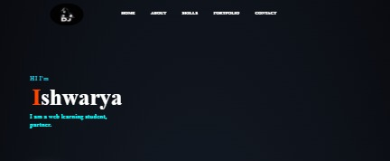
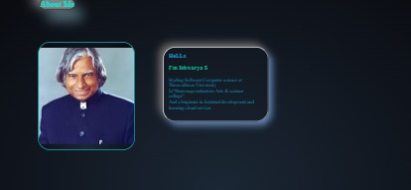
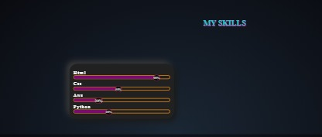
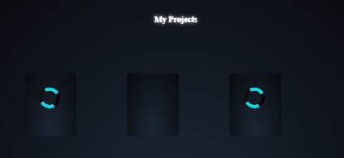

RESULTS AND SCREENSHOTS
11

Slide 12
CONCLUSION
Project ConclusionThe portfolio website project has been successfully designed and developed to showcase Ishwarya S's skills and experience as a web and automation developer. The website provides a clean and modern interface, easy navigation, and a clear showcase of projects and accomplishments.
12

